Slide 1

AXON
HEALTHCARE
HEALTHCARE
ANALYTICS
Integrated Dashboard & SQL Analysis
Clinical Visits • Diagnostics • Treatment • Insurance • Patient Analytics
Excel | Tableau | Power BI | SQL
GROUP 3

Slide 2
PROJECT TEAM
Group members
Prepared By
Arunprasad Rajesh Kounder
arun14899k@gmail.com
Samreen Sayed
sayed.samreen16@gmail.com
Karthik Hamilpurkar
karthikhamilpurkar@gmail.com
Project focus: build an integrated healthcare reporting solution using dashboards and SQL.
AXON HEALTHCARE | Healthcare Analytics
2

Slide 3
PROJECT OVERVIEW & SUMMARY
What the project covers
Objective
Total Patients
Total Visits
Create a unified analytical view of patient activity, clinical visits, diagnostic testing, treatment outcomes, insurance and financial information.
10,000
10,000
Revenue
Chronic Rate
Analytics layers
$25.41M
80.35%
• Excel — dashboard-oriented analysis and presentation
• Tableau — visual exploration of treatment and insurance
• Power BI — clinical, executive and patient analytics
• SQL — relational data model, validation and extraction
Average Age
Treatment Success
48.94
33.01%
AXON HEALTHCARE | Healthcare Analytics
3

Slide 4
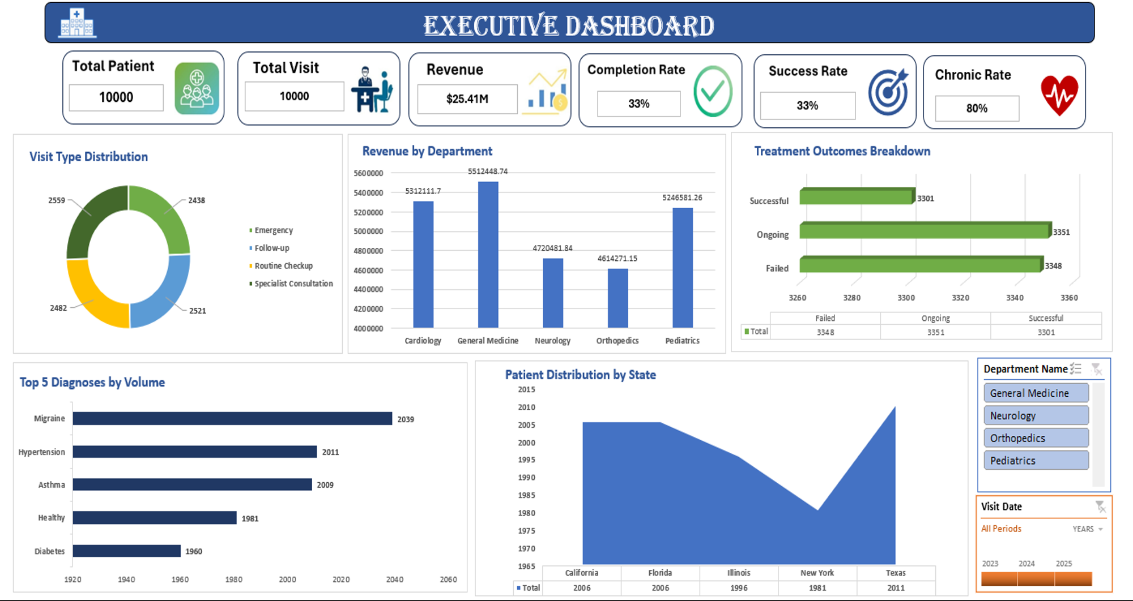
EXCEL DASHBOARD — EXECUTIVE
Management-level view of healthcare performance
AXON HEALTHCARE | Healthcare Analytics
4

Slide 5
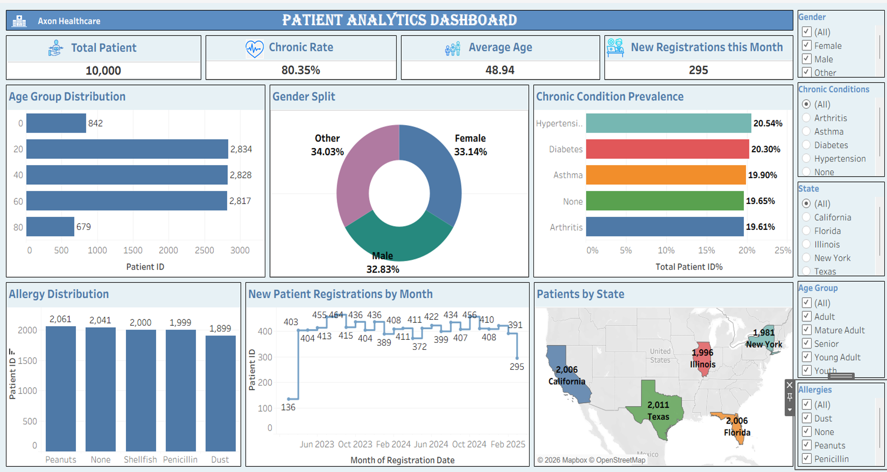
TABLEAU DASHBOARD — PATIENT ANALYTICS
Demographics, chronic conditions and registrations
AXON HEALTHCARE | Healthcare Analytics

Slide 6
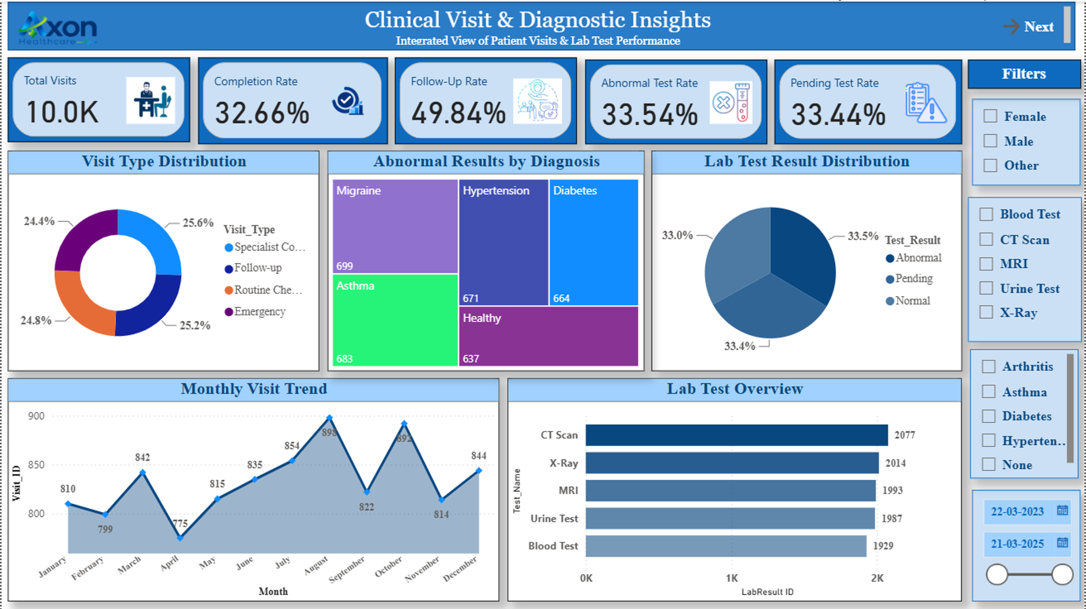
POWER BI DASHBOARD
Clinical Visit & Diagnostic Insights
Power BI dashboard highlights
• 10.0K total visits
• 32.66% completion rate
• 49.84% follow-up rate
• 33.54% abnormal test rate
• 33.44% pending test rate
• CT Scan is the largest displayed lab-test category
Interactive filters include gender, test type, diagnosis and date range.
AXON HEALTHCARE | Healthcare Analytics
6

Slide 7
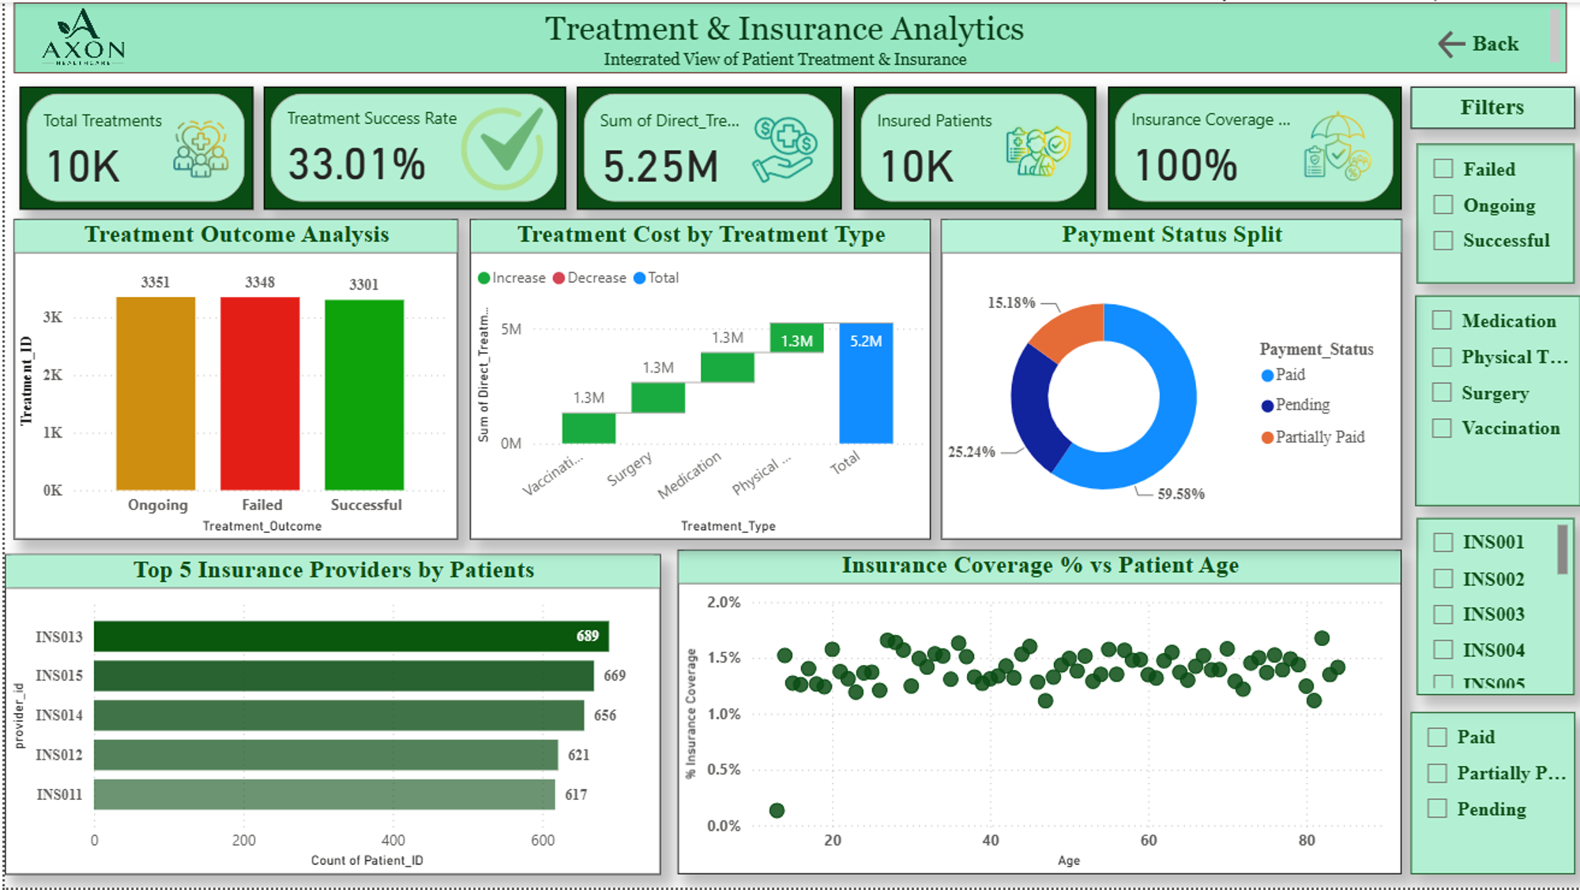
POWER BI DASHBOARD
Treatment & Insurance Analytics
Power BI dashboard highlights
• 10K total treatments
• 33.01% treatment success rate
• 5.25M direct-treatment amount shown
• 100% insurance coverage shown
• Paid payments: 59.58%
• Top provider displayed: INS013 — 689 patients
Filters support treatment outcome, treatment type, provider and payment status analysis.
AXON HEALTHCARE | Healthcare Analytics
7

Slide 8
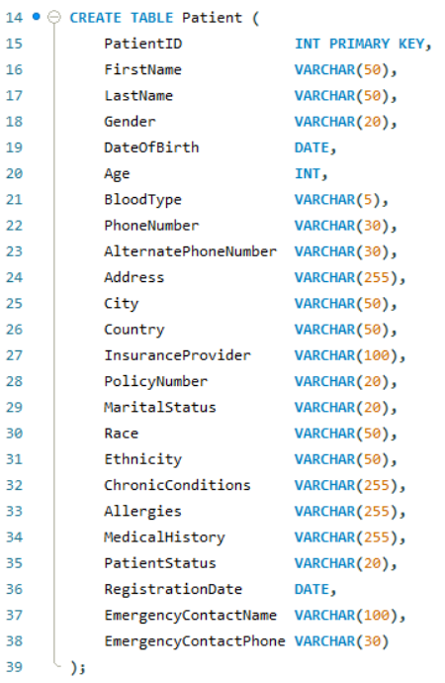
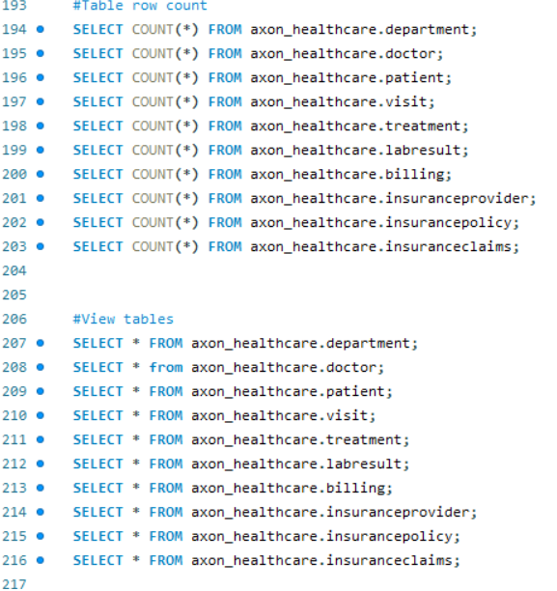
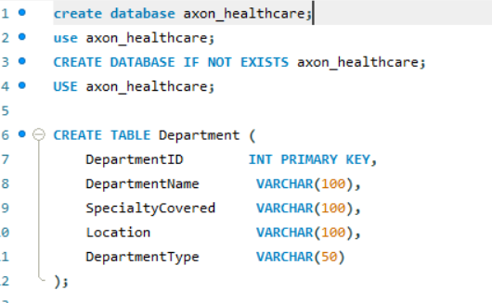
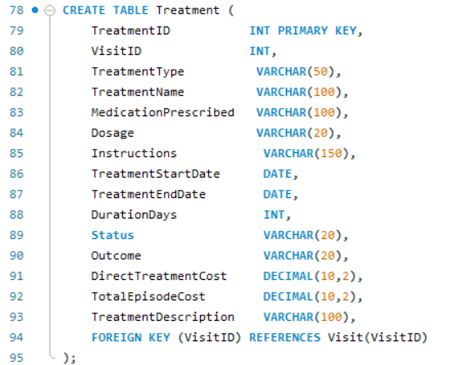
MySQL DATABASE & DATA MODEL
Relational healthcare schema
Department → Doctor → Visit → Treatment / Lab Result → Billing
• Primary keys identify core records.
• Foreign keys connect patients, doctors, visits and downstream clinical/financial records.
• Patient table includes demographics, insurance, chronic conditions and allergies.
• Visit and Treatment tables capture clinical activity and treatment outcomes.
AXON HEALTHCARE | Healthcare Analytics
8

Slide 9
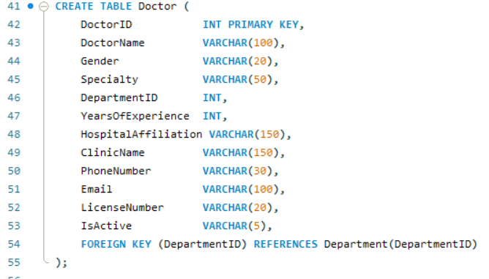
MySQL — VALIDATION & SUPPORTING TABLES
Data checks and operational tables
Supporting schema
• Lab Result stores test date, test name, result, numeric value, units and reference range.
• Billing stores billed amount, insurance covered, patient paid, outstanding amount and payment status.
• COUNT(*) queries validate table populations after loading.
• SELECT * queries provide table-level inspection before reporting.
AXON HEALTHCARE | Healthcare Analytics
9

Slide 10
KEY FINDINGS & RECOMMENDATIONS
Final project summary
Key Findings
Recommendations
• 10,000 patients and 10,000 visits are displayed in the executive/clinical dashboards.
• Completion rate is 32.66%; treatment success rate is 33.01%.
• Abnormal and pending lab-test rates are each about one-third.
• General Medicine shows the highest displayed department revenue (~$5.51M).
• Migraine is the highest-volume diagnosis shown (2,039).
• Hypertension has the highest displayed chronic-condition prevalence (20.54%).
• Improve visit completion and treatment follow-through.
• Investigate failed and ongoing treatment cases.
• Reduce pending diagnostic-test backlog and prioritize abnormal results.
• Monitor department revenue and treatment economics.
• Use demographic and condition filters for targeted planning.
• Monitor payment status and insurance-provider performance.
AXON HEALTHCARE | Healthcare Analytics
10

Slide 11
AXON
HEALTHCARE
THANK
YOU
Healthcare Analytics Dashboard
Arunprasad Rajesh Kounder • Samreen Sayed • Karthik Hamilpurkar
Excel | Tableau | Power BI | MySQL

